Slide 1



Climate Change Belief Analysis 2022
Alicia Reddy

Slide 2


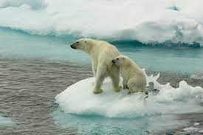
Contents
Introduction
Data Analysis
Data Pre-processing
Modelling
Evaluation
Conclusion

Slide 3




Introduction
Many companies are built around lessening one’s environmental impact or carbon footprint. They offer products and services that are environmentally friendly and sustainable, in line with their values and ideals. They would like to determine how people perceive climate change and whether or not they believe it is a real threat. This would add to their market research efforts in gauging how their product/service may be received.
This predict is based on creating a Machine Learning model that is able to classify whether a person believes in climate change, based on their novel tweet data.
Providing an accurate and robust solution to this task gives companies access to a broad base of consumer sentiment, spanning multiple demographic and geographic categories - thus increasing their insights and informing future marketing strategies.

Slide 4


Data Analysis
2: News
The tweet links to factual news about climate change
The train dataset contains three columns which are sentiment, tweet message and tweet id while the test dataset contains the tweet message and the tweet id column.
The sentiment column has four classes which are represented by four numbers 2, 1, 0 and -1.
1: Pro
The tweet supports the belief of man-made climate change
0: Neutral
The tweet neither supports nor refutes the belief of man-made climate
- 1: Anti
The tweet does not believe in man-made climate change

Slide 5
Data Analysis
Tweets & Sentiments
Number of observations
15,819
Tweet ID
No Missing Data

Slide 6
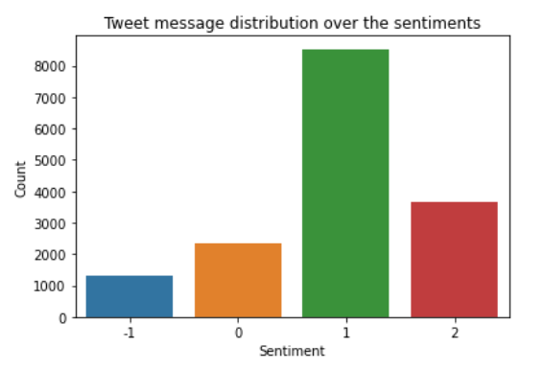
Data Analysis
Bar Graph Plot showing message distribution over the classes.

Slide 7
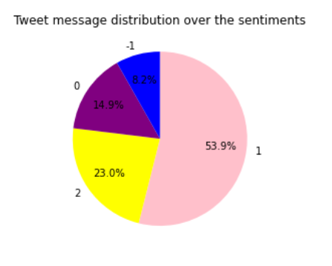
Data Analysis
Pie Chart Plot showing distribution over the sentiments.

Slide 8
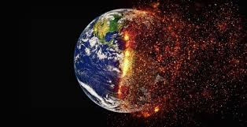
The visualizations above indicate that :
There are 8530 tweet messages on count that support the belief of man-made climate change(sentiment: 1), which is 53.9% There are 1296 tweet messages on count that do not believe in man-made climate change(sentiment: -1), which is 8.2%. There are 2353 tweet messages on count where the tweet message neither supports or refutes the belief of man-made climate change(sentiment: 0), which is 14.9%. There are also 3640 tweet messages on count which link factual news about climate change, and gives about 23.0% We then conclude that the distribution of tweets messages are unevenly distributed in the four given classes.

Slide 9
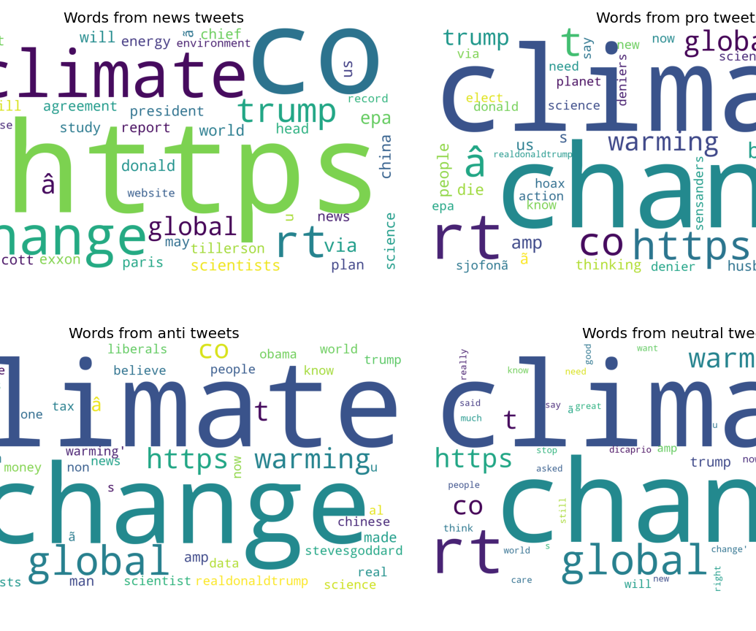
Word Clouds
The Climate Change words seems to be the most frequently used word in all the tweet classes. This implies that both classes are tweeting about the Climate Change since it is the main topic.

Slide 10
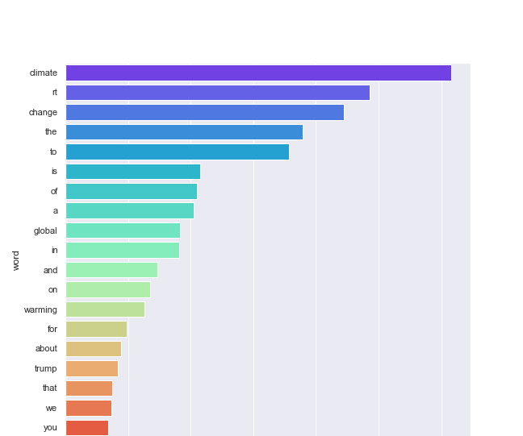
Word Frequency Analysis
The Climate Change words seems to be the most frequently used word in all the tweet classes. This implies that both classes are tweeting about the Climate Change since it is the main topic.

Slide 11
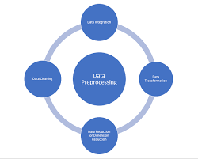
Data Pre-processing
The following steps were performed for both the train and the test dataset.
Checking for nulls
Checking for blank strings
Replacing URLs: Links starting with "http" or "https" or "www" are replaced by "URL".
Converting text to Lower Case
Removing Stopwords: Stopwords are the English words which do not add much meaning to a sentence. They can safely be ignored without sacrificing the meaning of the sentence.
Lemmatizing: Lemmatization is the process of converting a word to its base form.

Slide 12
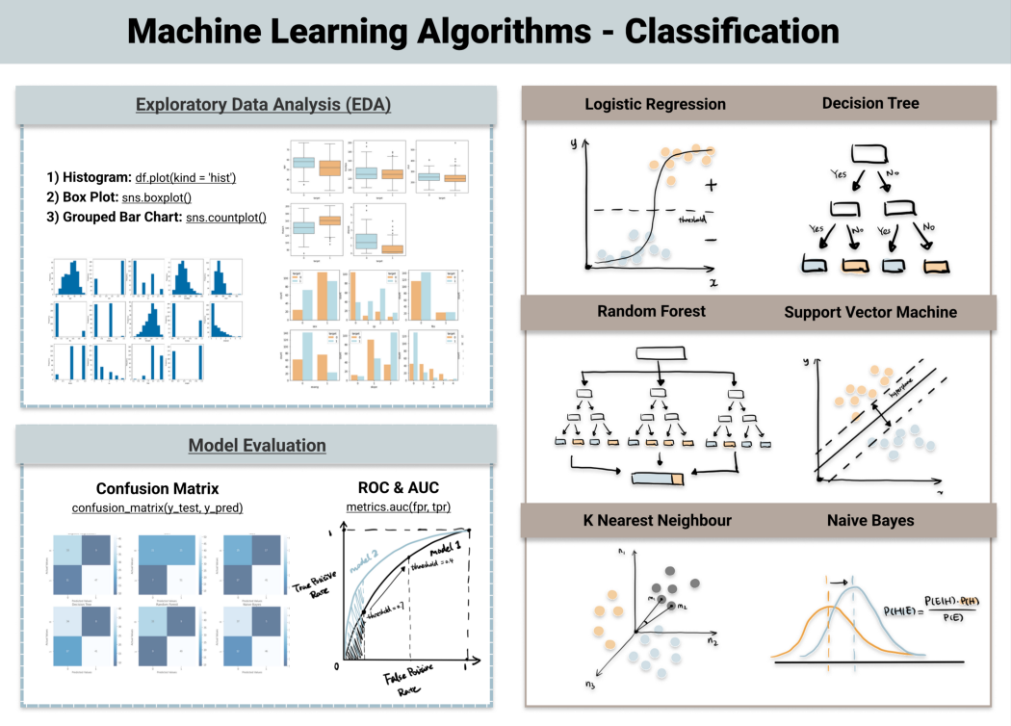
Modelling
Logistic Regression
Linear SVC
Multinomial Naive Bayes
Support Vector Machine
K Neighbors Classifier

Slide 13
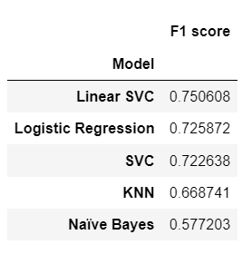
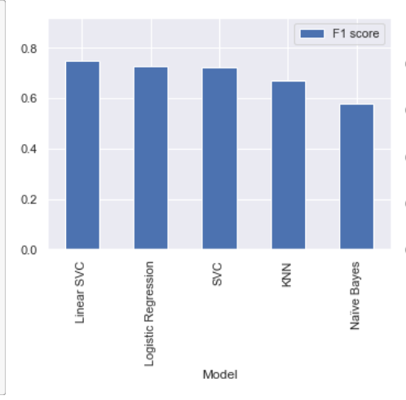
Evaluation The F1 score is our main metric that we use to decide on the best model to use. Below is a data frame that shows the models with their respective F1 scores from the largest score (i.e best model) to the lowest (i.e poor model).
F1 Scores
Box plot based on f1 scores

Slide 14

Conclusion
Based on the accuracy scores from the five fitted models above, LinearSCV is the one which gives a higher score than the rest which tells us that this is the best model to use to predict the sentiment of the tweet messages.
Linear SVC models supports both dense and sparse input.The Linear Support Vector Classifier (SVC) method applies a linear kernel function to perform classification and it performs well with a large number of samples. If we compare it with the SVC model, the Linear SVC has additional parameters such as penalty normalization which applies 'L1' or 'L2' and loss function. After working through the given data and through classification , It should be noted that there were far fewer denier tweets than believer tweets, with a split of about 6% compared to 94%.

Slide 15
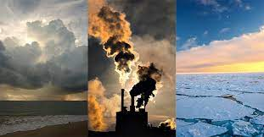


Thank You

